Slide 1

Most popular music genres per Billboard Hot 100
Our team project focused on tracking music data trends from the Billboard Hot 100 songs (singles) list from 2000 to 2017.
For our analysis, we considered the following questions:
How is “popularity” of a song determined by Billboard Hot 100?
What genres were the most popular in the Hot 100 list over the years and how is has changed over the years?
Which were the top 5 artist/tracks in the lists?
How does the danceability quality of songs change over time?
Would other tracking lists (i.e. Rapid, Last FM) would support the Billboard trends?

Slide 2
Billboard Hot 100
The Billboard Hot 100 is the music industry standard record chart in the United States for songs, published weekly by Billboard magazine.
Chart rankings are based on physical and digital sales, radio play, and online streaming in US.
Tracking week for sales and streaming begins on Friday and ends on Thursday, while radio play tracking-week runs from Monday to Sunday. New charts are compiled and officially released to the public on Tuesdays.
The main purpose of the Hot 100 is to reflect the popularity of the singles, albums, etc., and to track the trends of the buying public.

Slide 3
Other sources used
Rapid API: 30,000 radio stations and music charts
Streams daily updated urls, classified by music genre and countries (over 130 countries and 167 music genres)
Last.fm
Builds a detailed profile of user’s musical taste by recording details of the tracks listened from internet radio stations, users’ computers, or portable music devices. Information is transferred to Last.fm’s database either via the music player itself (Spotify, Deezer, Tidal, etc.) or via a plug-in installed into users’ music player.

Slide 4
Billboard Hot 100 data mining and analysis
Using the Billboard Hot 100 url and api key, a dataset was extracted to begin the analysis

Slide 5
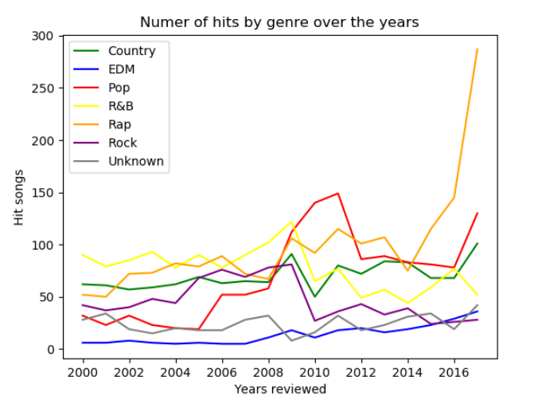
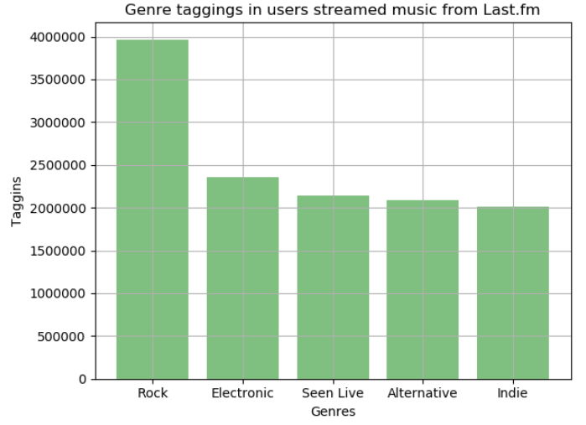

Slide 6
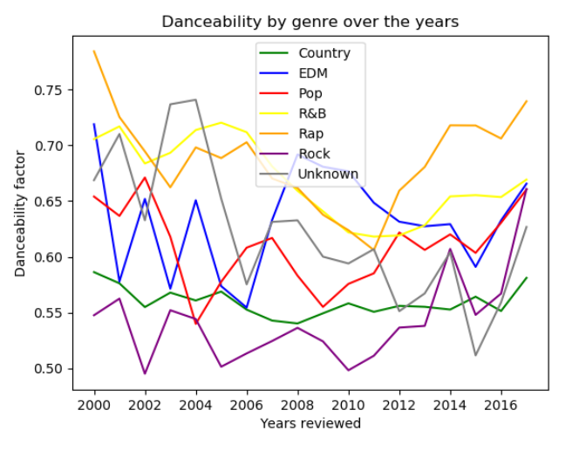
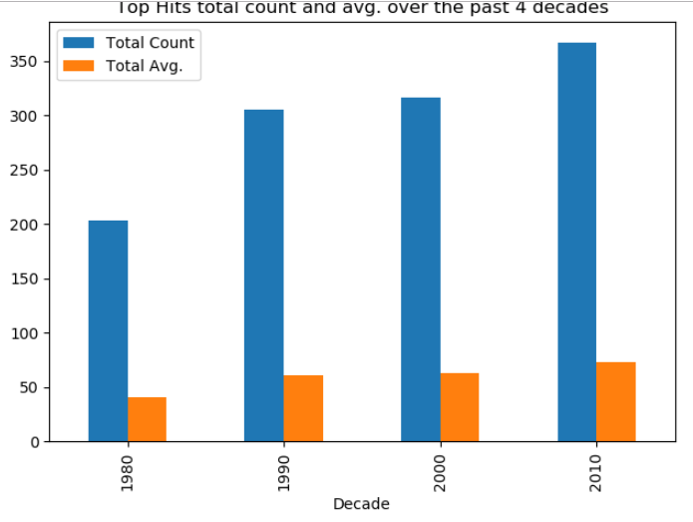

Slide 7
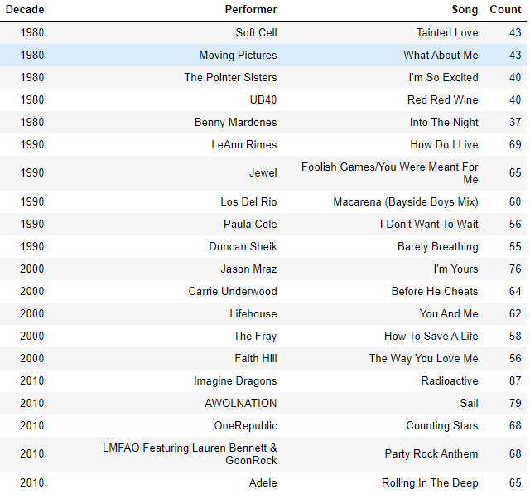
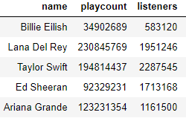
Billboard Hot 100 vs Last.fm – Top Artists

Slide 8
